Slide 1

PCSE214- MOBILE APPLICATION DEVELOPMENT
CHAPTER VIII
NOTIFICATIONS
By: Mr. Tobias Kakooza.
Professional Certificate in Software Engineering

Slide 2
OBJECTIVES
Define Notifications and their importance
Describe the implementation of Notifications
Discuss different type and form of notifications.

Slide 3
Definition
A notification is a message you can display to the user outside of your application's normal UI. When you tell the system to issue a notification, it first appears as an icon in the notification area. To see the details of the notification, the user opens the notification drawer. Both the notification area and the notification drawer are system-controlled areas that the user can view at any time.

Slide 4

Notification -Implementation
Android Toast class provides a handy way to show users alerts but problem is that these alerts are not persistent which means alert flashes on the screen for a few seconds and then disappears.

Slide 5
Notification –Implementation contd..
To see the details of the notification, you will have to select the icon which will display notification drawer having detail about the notification. While working with emulator with virtual device, you will have to click and drag down the status bar to expand it which will give you detail as follows. This will be just 64 dp tall and called normal view.

Slide 6
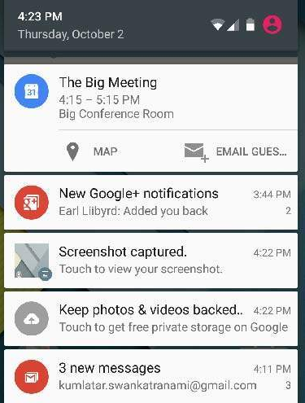
Notification –Toast Display..

Slide 7
Notification –Toast Display contd...
Above expanded form can have a Big View which will have additional detail about the notification. You can add upto six additional lines in the notification. The following screen shot shows such notification.

Slide 8
Creating and Sending Notification
You have simple way to create a notification. Follow the following steps in your application to create a notification −

Slide 9
Creating and Sending Notification – Step 1 (Create Builder)
As a first step is to create a notification builder using NotificationCompat.Builder.build(). You will use Notification Builder to set various Notification properties like its small and large icons, title, priority etc.

Slide 10

Creating and Sending Notification – Step 2 (Setting Properties)
Once you have Builder object, you can set its Notification properties using Builder object as per your requirement. But this is mandatory to set at least following −
A small icon, set by setSmallIcon()
A title, set by setContentTitle()
Detail text, set by setContentText()

Slide 11
Creating and Sending Notification – Step 3 (Attach Actions)
This is an optional part and required if you want to attach an action with the notification. An action allows users to go directly from the notification to an Activity in your application, where they can look at one or more events or do further work.
The action is defined by a PendingIntent containing an Intent that starts an Activity in your application. To associate the PendingIntent with a gesture, call the appropriate method of NotificationCompat.Builder. For example, if you want to start Activity when the user clicks the notification text in the notification drawer, you add the PendingIntent by calling setContentIntent().
A PendingIntent object helps you to perform an action on your applications behalf, often at a later time, without caring of whether or not your application is running.
We take help of stack builder object which will contain an artificial back stack for the started Activity. This ensures that navigating backward from the Activity leads out of your application to the Home screen.

Slide 12
Creating and Sending Notification – Step 3 contd…
Intent resultIntent = new Intent(this, ResultActivity.class);
TaskStackBuilder stackBuilder = TaskStackBuilder.create(this);
stackBuilder.addParentStack(ResultActivity.class);
// Adds the Intent that starts the Activity to the top of the stack
stackBuilder.addNextIntent(resultIntent);
PendingIntent resultPendingIntent = stackBuilder.getPendingIntent(0,PendingIntent.FLAG_UPDATE_CURRENT);
mBuilder.setContentIntent(resultPendingIntent);

Slide 13
Creating and Sending Notification – Step 4 (Issue the Notification)
Finally, you pass the Notification object to the system by calling NotificationManager.notify() to send your notification. Make sure you call NotificationCompat.Builder.build() method on builder object before notifying it. This method combines all of the options that have been set and return a new Notification object.
NotificationManager mNotificationManager = (NotificationManager) getSystemService(Context.NOTIFICATION_SERVICE);
// notificationID allows you to update the notification later on.
mNotificationManager.notify(notificationID, mBuilder.build());

